Slide 1
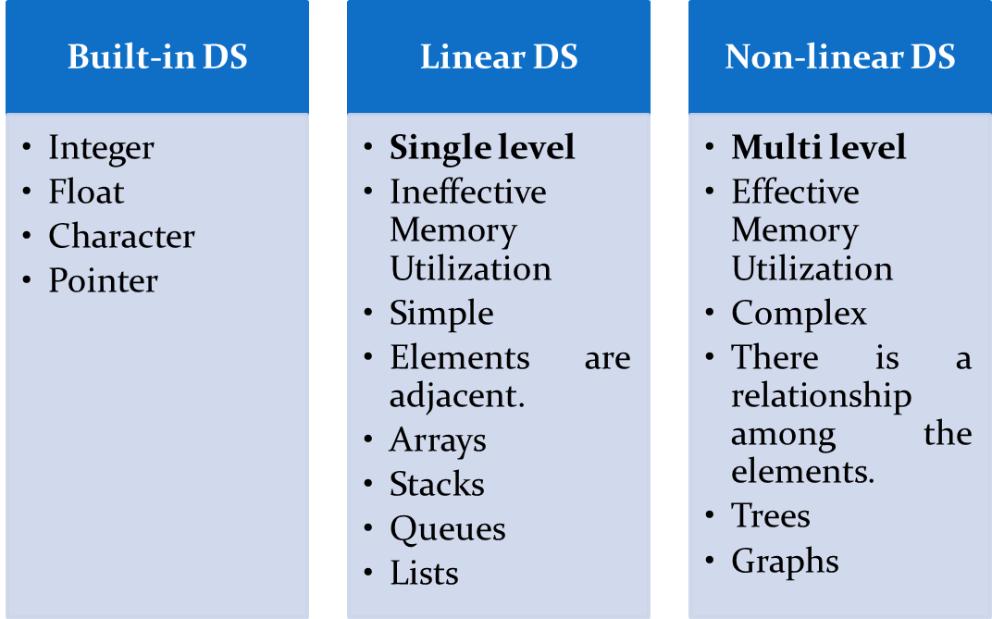
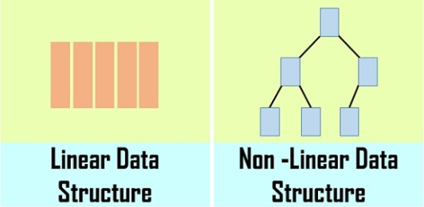
Advanced Data Structure and Algorithms
Data Structure = Data Organization + Data Management + Storage format.
Enables efficient access and modification.
Advantage - Reduce the space and time complexities
‹#›

Slide 2
Advanced Data Structure and Algorithms
Trees
Graphs
Hashing
Search trees, Indexing, and multiways trees
File Organization
‹#›

Slide 3

1. TREES
Tree- basic terminology
General tree and its representation
Binary tree
Properties
Converting tree to binary tree
Tree traversals
Binary Search Tree (BST)
Threaded binary tree
Creation and Traversals
Case Study- Use of binary tree in expression tree-evaluation and Huffman's coding
‹#›

Slide 4
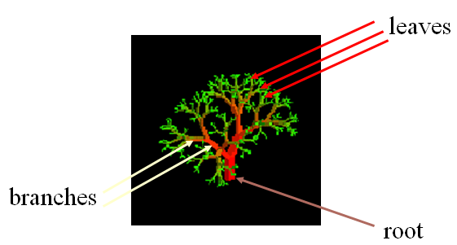
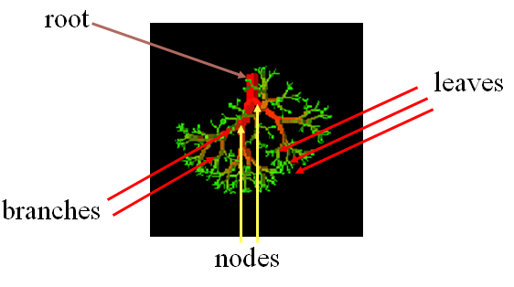
TREE - Definition
A tree is a finite nonempty set of elements.
It is an abstract model of a hierarchical structure.
Consists of nodes with a parent-child relation.
Applications-
File systems
Organization charts
Databases
Social Networking
PDF file format
‹#›

Slide 5
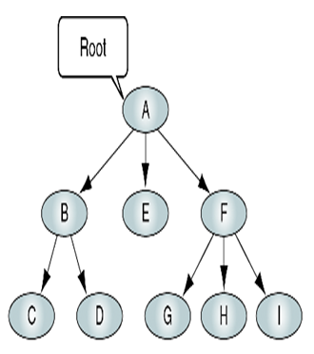
Basic Trees Concepts
A Tree consists of finite set of elements called Nodes and finite set of directed lines called Branches.
Number of branches associated with a node is the degree of a node. For example, degree of A is 3.
If the tree is not empty the first node is called Root.
All nodes in tree can have zero, one or more branches.
‹#›

Slide 6
Terminology
A root node without parent.
A leaf node is any node with outdegree Zero i.e. no successor.
Nodes with no children are called leaves, or external nodes.
A node is a parent if it has successor nodes.
A node with a predecessor is a child.
Two or more nodes with same parent are siblings.
An ancestor is any node in the path from root to the node -parent, grandparent, grand-grandparent, etc.
A descendent is any node in the path below the parent node - child, grandchild, grand-grandchild, etc.
Level of node is its distance from the root.
Siblings are always at same level
Height of the tree is the level of the leaf in the longest path from the root plus 1.
Depth of the tree is maximum level of any node.
‹#›

Slide 7
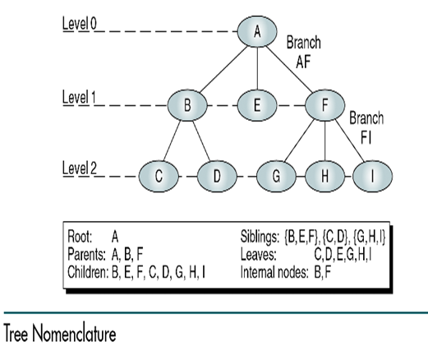
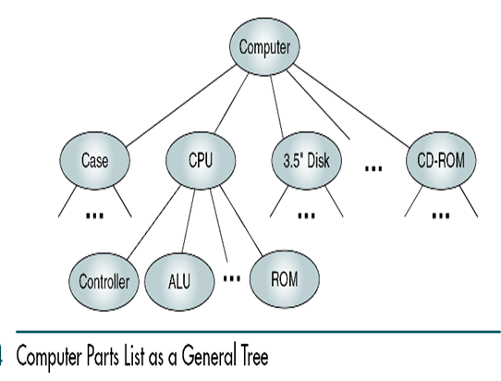
‹#›

Slide 8
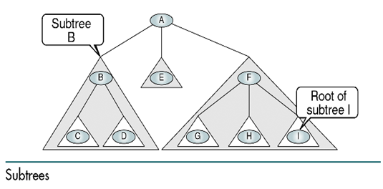
Terminology
Subtree: Tree consisting of a node and its descendants.
‹#›

Slide 9
Recursive definition of a tree
A tree is a set of nodes that either:
is empty or
has a designated node, called the root, from which hierarchically descend zero or more subtrees, which are also trees.
Tree representation
General Tree – organization chart format
Indented list –the assembly structure of an item
Parenthetical Listing- where each open parenthesis indicates the start of a new level and each closing parenthesis completes the current level and moves up one level in the tree.
‹#›

Slide 10
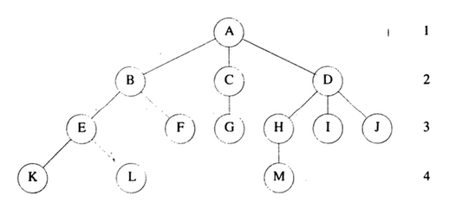

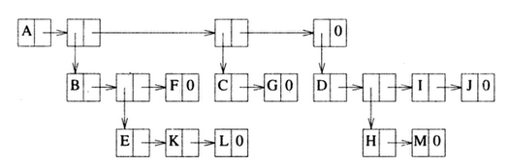
Parenthetical Listing
Indented list
( A ( B ( E ( K, L ), F ), C ( G ), D ( H ( M ), I, J ) ) )
The root comes first, followed by a list of links to sub-trees
‹#›

Slide 11

Tree Representation
LIST Representation
How many link fields are needed in
such a representation?
NODE Structure
‹#›

Slide 12
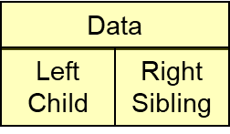
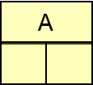
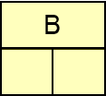
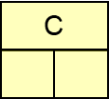
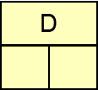
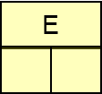
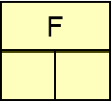
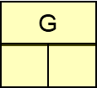
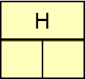
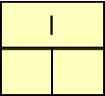
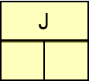
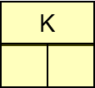
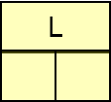
Left Child, Right Sibling Representation
‹#›
Notes:
‹#›

Slide 13
Tree ADT
We use positions to abstract nodes
Generic methods:
integer size()
boolean isEmpty()
objectIterator elements()
positionIterator positions()
Accessor methods:
position root()
position parent(p)
positionIterator children(p)
Query methods:
boolean isInternal(p)
boolean isExternal(p)
boolean isRoot(p)
Update methods:
swapElements(p, q)
replaceElement(p, o)
Additional update methods may be defined by data structures implementing the Tree ADT
‹#›
Notes:
‹#›

Slide 14
Binary tree

Slide 15
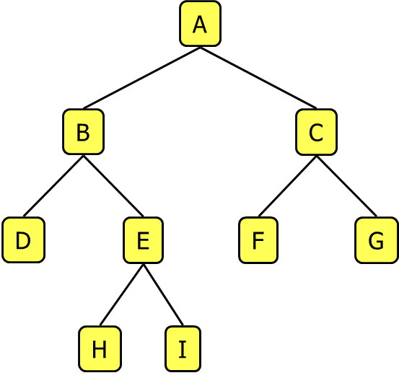
Binary Tree
Applications:
arithmetic expressions
decision processes
searching
A binary tree is a tree with the following properties:
Each internal node has at most two children (degree of two)
The children of a node are an ordered pair
We call the children of an internal node left child and right child
Alternative recursive definition: a binary tree is either
a tree consisting of a single node, OR
a tree whose root has an ordered pair of children, each of which is a binary tree.
‹#›
Notes:
‹#›

Slide 16
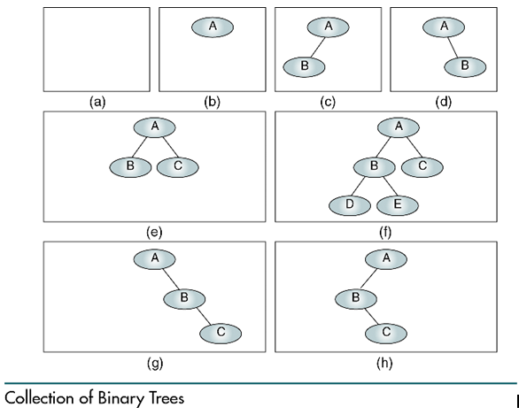
A null tree is a tree with no nodes
‹#›

Slide 17
BinaryTree ADT
The BinaryTree ADT extends the Tree ADT, i.e., it inherits all the methods of the Tree ADT.
Additional methods:
position leftChild(p)
position rightChild(p)
position sibling(p)
Update methods may be defined by data structures implementing the BinaryTree ADT.
‹#›
Notes:
‹#›

Slide 18
Examples of the Binary Tree
Skewed Binary Tree
Complete Binary Tree
A
1
A
A
B
B
2
B
C
C
3
D
E
F
G
D
4
H
I
E
5
‹#›
Notes:
‹#›

Slide 19
Arithmetic Expression Tree
Binary tree associated with an arithmetic expression
internal nodes: operators
external nodes: operands
Example: arithmetic expression tree for the expression
(2 × (a − 1) + (3 × b))
+
×
×
2
−
3
b
a
1
‹#›
Notes:
‹#›

Slide 20
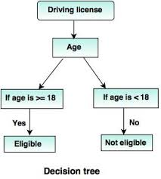
Decision Tree
Binary tree associated with a decision process
internal nodes: questions with yes/no answer
external nodes: decisions
Example:
‹#›
Notes:
‹#›

Slide 21
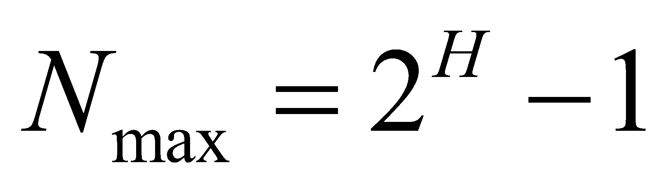
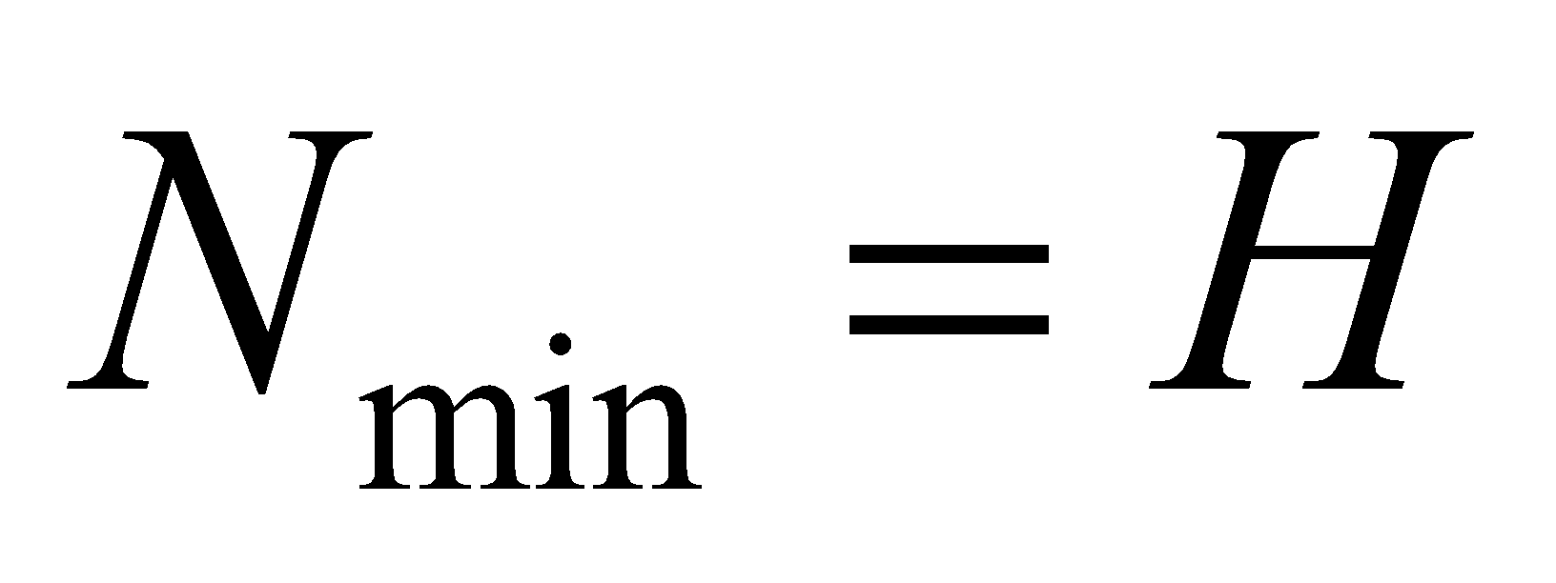
Properties of Binary trees
N is number of nodes (Minimum nodes)
H is height of the binary tree
Maximum Nodes
Total no. of external nodes = Internal nodes + 1.
‹#›

Slide 22
Properties of Binary trees – Access path
The children of any node in a tree can be accessed by-
Following only one branch path, the one that leads to the desired node.
The nodes at level 1, which are children of the root, can be accessed by following only one branch;
The nodes of level 2 of a tree can be accessed by following only two branches from the root, etc.
‹#›

Slide 23
Maximum Number Of Nodes
With H height.
Maximum number of node= 1 + 2 + 4 + 8 + … + 2^{H-1}
= 2^{H} - 1
‹#›

Slide 24
Number Of Nodes & Height
Let n be the number of nodes in a binary tree whose height is h.
h <= n <= 2^{h} – 1
log₂(n+1) <= h <= n
‹#›

Slide 25
Full Binary Tree
A full binary tree of a given height h has 2^{h} – 1 nodes.
Height 4 full binary tree.
‹#›

Slide 26
Numbering Nodes In A Full Binary Tree
Number the nodes 1 through 2^{h} – 1.
Number by levels from top to bottom.
Within a level number from left to right.
1
2
3
4
5
6
7
8
9
10
11
12
13
14
15
‹#›

Slide 27
Node Number Properties for Left & Right child
1
2
3
4
5
6
7
8
9
10
11
12
13
14
15
For i^{th} node → Number of its left child is 2i; provided 2i < n
If 2i > n, node i has no left child.
For i^{th} node → Number of its right child is 2i + 1; provided 2i+1 < n
If 2i + 1 > n, node i has no right child.
‹#›

Slide 28
Complete Binary Tree With n Nodes
Start with a full binary tree that has at least n nodes.
Number the nodes as described earlier.
The binary tree defined by the nodes numbered 1 through n is the unique n node complete binary tree.
Complete binary tree with 10 nodes.
1
2
3
4
5
6
7
8
9
10
11
12
13
14
15
‹#›

Slide 29
Binary Tree Representation Array & Linked Representation
Array Representation -
Number the nodes using the numbering scheme for a full binary tree.
The node that is numbered i is stored in tree[i].
1
a
2
3
b
c
4
5
6
7
d
e
f
g
8
9
10
h
i
j
tree[]
a
b
c
d
e
f
g
h
i
j
0
5
‹#›
10

Slide 30
Right-Skewed Binary Tree
1
a
b
3
7
c
15
d
tree[]
a
-
b
-
-
-
c
-
-
-
-
-
-
-
d
1
2
3
4
5
5
6
7
8
9
10
10
11
12
13
14
15
15
A n node binary tree needs an array whose length is between n+1 and 2^{n}.
‹#›

Slide 31
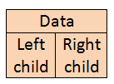
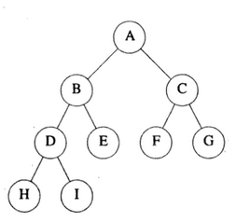
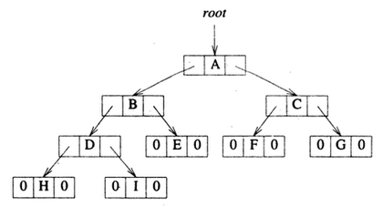
Linked Representation
Each binary tree node is represented as an object with data type is BinaryTree.
For n node binary tree → Required space is n * (space required by one node).
‹#›
Notes:
‹#›
Notice that a linked representation always take space that is linear in the number of elements in the tree. An array representation may take an exponential amount of space!

Slide 32
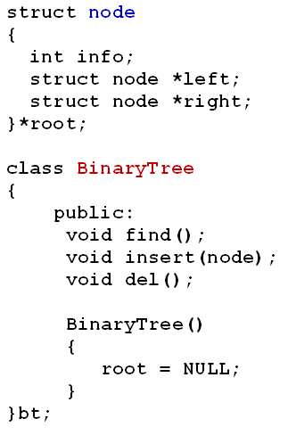
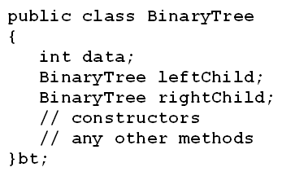
The Class BinaryTree
OR
‹#›

Slide 33
Converting a Tree to Binary Tree
Use the root of the general tree as the root of the binary tree.
Left child remains the left child of a node.
Right sibling becomes the right child of another node (previous sibling).
Repeat the process.
The resulting tree is a binary tree but not a Full Binary tree OR binary search tree.
A
A
B
Binary Tree
C
E
B
C
D
F
D
G
E
F
G
H
I
H
‹#›
I

Slide 34
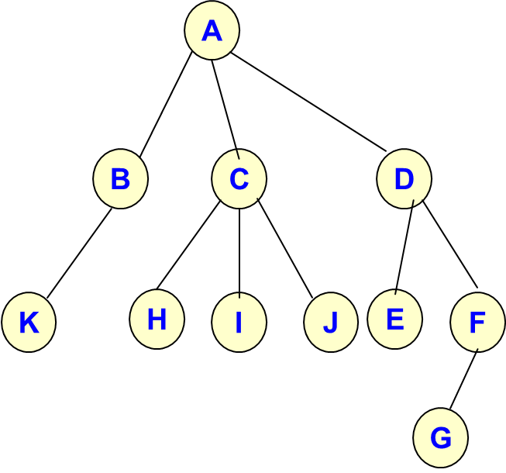
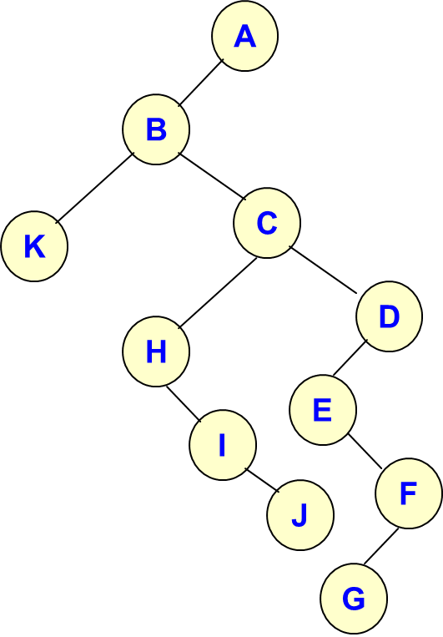
Converting a Tree to Binary Tree - Example
General tree
Binary tree
‹#›

Slide 35
Binary Tree Operations
Determine the height and the number of nodes.
Searching
Insertion
Deletion
Sorting
Display the binary tree – Traversals
Make a clone.
Determine if two binary trees are clones.
Evaluate the arithmetic expression represented by a binary tree.
Obtain the infix, prefix, and postfix forms of an expression.
‹#›

Slide 36
Binary Tree Traversal
Binary tree operations are done by performing a traversal of the binary tree.
In a traversal, each element of the binary tree is visited exactly once.
During the visit of an element, all action (make a clone, display, evaluate the operator, etc.) with respect to this element is taken.
Methods-
Preorder (Visit Root, Traverse Left child, Traverse Right child)
Inorder (Traverse Left child, Visit Root, Traverse Right child)
Postorder (Traverse Left child, Traverse Right child, Visit Root)
‹#›

Slide 37
Illustrations for Traversals
PREORDER (Depth First)
1. Visit the root.
2. Traverse the left subtree in preorder
3. Traverse the right subtree in preorder
6
1
4
5
9
8
7
INORDER
Traverse the left subtree in inorder
Visit the root.
3. Traverse the right subtree in inorder
3
2
Preorder:
6 1 5 9 3 4 8 7 2
Inorder:
5 1 3 9 6 8 4 2 7
Postorder:
5 3 9 1 8 2 7 4 6
POSTORDER
Traverse the left subtree in postorder
Traverse the right subtree in postorder
Visit the root.
‹#›

Slide 38
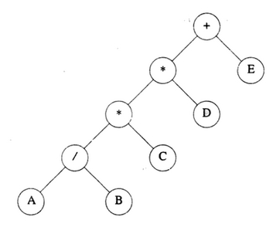
Illustrations for Traversals
Preorder:
+ * * / A B C D E
Inorder:
A / B * C * D + E
Postorder:
A B / C * D * E +
‹#›

Slide 39
Code for the Traversal Techniques
void preOrder(Node *bt){
if (bt != NULL) {
cout << bt → data;
preOrder(bt → left);
preOrder(bt → right);
}
}
void preOrder(Node *bt){
if (bt == NULL) return;
cout << bt → data;
preOrder(bt → left);
preOrder(bt → right);
}
void inOrder(Node *bt){
if (bt != NULL) {
inOrder(bt → left);
cout << bt → data;
inOrder(bt → right);
}
}
void postOrder(Node *bt){
if (bt != NULL) {
postOrder(bt → left);
postOrder(bt → right);
cout << bt → data;
}
}
‹#›
VIDEO link (Recursive inorder) - https://www.youtube.com/watch?v=vpXcceCmSbg

Slide 40
Preorder Traversals- Non recursive
If(root !=NULL)
{
pt = root;
while(1)
{
while(pt!=NULL) {
print pt->data;
push(pt)
pt=pt->left;
}
if (stack is not empty) {
pop pt;
pt=pt->right;
}
else
return;
}
}
6
1
4
5
9
8
7
3
2
1. create an empty stack ; push root to it
2. Pop all items; Do following for every popped item
a) print it
b) push its right child
c) push its left child
# Note that right child is pushed first so that left is processed first
‹#›

Slide 41
Inorder Traversals- Non recursive
6
pt=root;
while(1)
{
while(pt!=NULL)
{
push pt;
pt = (pt->left);
}
if (stack is empty)
break;
pop pt;
Print pt;
pt = pt->right;
}
1
4
5
9
8
7
3
2
1) Create an empty stack S.
2) Initialize current node as root
3) Push the current node to S and set current = current->left till current=NULL
4) If current is NULL and stack is not empty then
a) Pop the top item from stack.
b) Print the popped item,
set current = popped_item->right
c) Go to step 3.
5) If current=NULL && stack is empty; exit
‹#›

Slide 42
Postorder Traversals- Non recursive (Iterative)
1.1 Create an empty stack
2.1 Do following while root != NULL
a) Push root's right child and then root to stack.
b) Set root as root's left child.
2.2 Pop an item from stack and set it as root.
a) If (popped item has a right child & this child is at top of stack) then
Remove the right child from stack;
Push the root back;
Set root as root's right child;
b) Else print root's data and set root as NULL.
2.3 Repeat steps 2.1 and 2.2 while stack is not empty.
‹#›

Slide 43
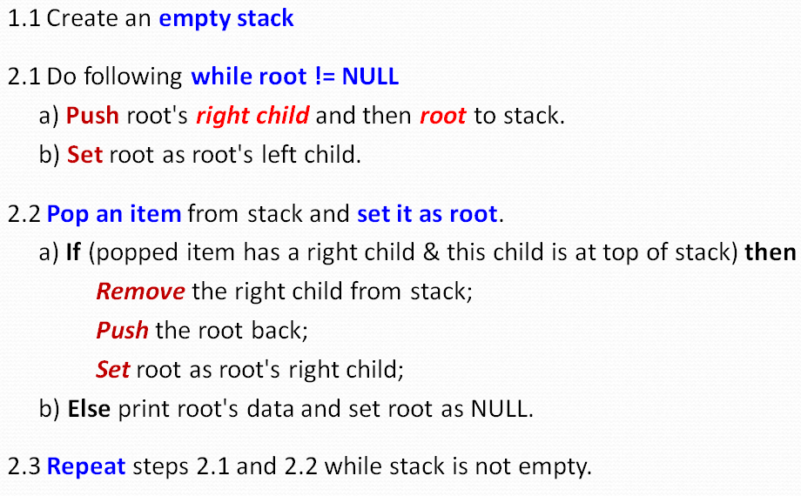
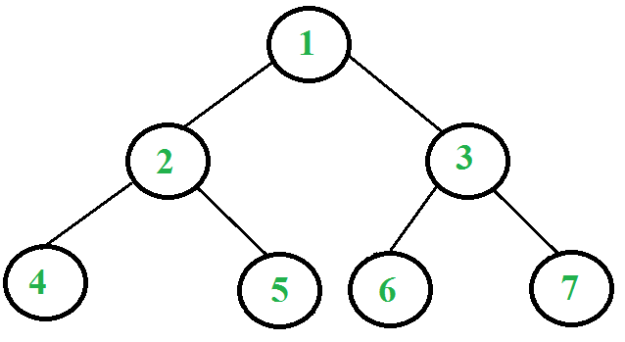
Example -Postorder Traversals Non recursive
d. Current node is NULL.
Pop 4; Right child of 4 doesn't exist.
Print 4. Set root = NULL
Stack: 3, 1, 5, 2
a. Right child of 1 exists. Push 3 to stack.
Push 1. Move to left child. Stack: 3, 1
b. Right child of 2 exists. Push 5 to stack.
Push 2. Move to left child. Stack: 3, 1, 5, 2
e. Current node is NULL.
Pop 2; 2→ right child = ToS
Pop 5; Push 2.
Root = 2 →right child i.e. 5
Stack: 3, 1, 2
c. Right child of 4 doesn't exist.
Push 4. Move to left child. Stack: 3, 1, 5, 2, 4
‹#›

Slide 44
Example -Postorder Traversals Non recursive
f. Right child of 5 doesn’t exists.
Push 5; Move to left child.
Stack: 3, 1 ,2, 5
h. Current node is NULL.
Pop 2; 2→ right child != ToS
Print 2.
Root = NULL; Stack: 3, 1
g. Current node is NULL.
Pop 5; Right child of 5 doesn't exist.
Print 5. Set root = NULL
Stack: 3, 1, 2
i. Current node is NULL.
Pop 1; 1→ right child = ToS
Pop 3; Push 1 back;
Root = 1 →right child i.e. 3
Stack: 1
‹#›
Repeat the same as above steps and Print 6, 7 and 3. Pop 1 and Print 1.

Slide 45
Inorder traversal without recursion – video link
https://www.geeksforgeeks.org/inorder-tree-traversal-without-recursion/
‹#›

Slide 46
Construct a binary tree from given sequences
In Order : DBFEAGCLJHK
Pre Order : ABDEFCGHJLK
In Order : DBFEAGCLJHK
Post Order : DFEBGLJKHCA
‹#›

Slide 47
Breadth first tree traversals /Level order traversals
Algorithm breadthFirst(root)
Set currentNode = root;
Createqueue();
loop(currentNode != NULL)
Process (currentNode)
if(left subtree != NULL)
enqueue (left subtree)
end if
if(right subtree != NULL )
enqueue (right subtree)
end if
if(Queue not empty)
set currentNode to dequeue()
else
set currentNode to NULL
end if
end loop
destroyqueue()
End breadthFirst
Visit children before visiting grand children
‹#›

Slide 48
Breadth-First Traversal
A
Current Node
B
C
A
D
E
F
G
OUTPUT
A
Queue
B | C
‹#›

Slide 49
Breadth-First Traversal
A
Current Node
B
B
C
D
E
F
G
OUTPUT
A
B
Queue
B | C | D | E
‹#›

Slide 50
Breadth-First Traversal
A
Current Node
C
B
C
D
E
F
G
OUTPUT
A
B
C
Queue
C | D | E | F | G
‹#›

Slide 51
Breadth-First Traversal
A
Current Node
D
B
C
D
E
F
G
OUTPUT
A
B
C
D
Queue
D | E | F | G
‹#›

Slide 52
Breadth-First Traversal
A
Current Node
E
B
C
D
E
F
G
OUTPUT
A
B
C
D
E
Queue
E | F | G
‹#›

Slide 53
Breadth-First Traversal
A
Current Node
F
B
C
D
E
F
G
OUTPUT
A
B
C
D
E
F
Queue
F | G
‹#›

Slide 54
Breadth-First Traversal
A
Current Node
G
B
C
D
E
F
G
OUTPUT
A
B
C
D
E
F
G
Queue
G
‹#›

Slide 55
Depth First Traversals
Visit the root and if moved to left child; process its entire left subtree.
If moved to right child; process its entire right subtree.
Relative order can differ (LRV, VLR, LVR, RLV)
Preorder
Postorder
Inorder
‹#›

Slide 56
Revision
Give definitions with real time examples for -
Degree of node
Leaf node
Root node
Branch Node
Indegree and Outdegree
Height of the tree
Right Subtree and Left Subtree
Null Tree
Explain with an example –
Full Binary Tree?
Complete binary tree
Given a binary tree; how to represent it in linear data structure?
How to represent following traversals in programming language notation?
Preorder, postorder, inorder, and breadth first traversals
‹#›

Slide 57
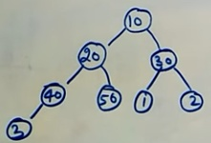

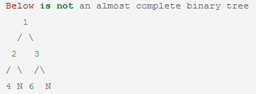
Complete Binary Tree -
A complete binary tree is a binary tree in which every level, except possibly the last, is completely filled, and all nodes are as far left as possible. It seems to mean a balanced tree.
OR
Addition of nodes follows level wise and left to right strategy.
10 20 30 40 50 1 2 3
A complete binary tree can have an incomplete last level.
A perfect binary tree is a complete binary tree in which the last level is full.
An almost complete binary tree is a complete but not perfect binary tree.
‹#›

Slide 58
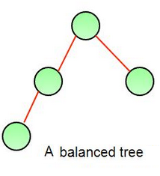
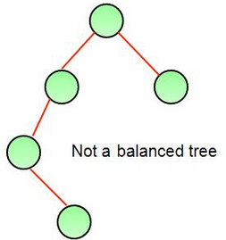
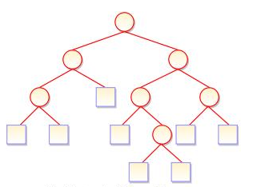


Balanced Binary Tree -
A binary tree is balanced if for each node; number of inner nodes in the left subtree and the number of inner nodes in the right subtree differ by atmost 1.
OR
For any two leaves the difference of the depth is at most 1.
Extended Binary Tree
Every internal node in the extended binary tree has exactly two children and every external node is a leaf. It displays the result which is a complete binary tree.
Nodes of the original tree
Special nodes replacing null subtree
‹#›
Notes:
‹#›

Slide 59
Binary Search Tree
‹#›

Slide 60
Binary Search Trees
A Binary Search Tree is a binary tree with the following properties:
All items in the left subtree are less than the root.
All items in the right subtree are greater or equal to the root.
Each subtree is itself a binary search tree.
OR
In a binary search tree
The left subtree contains key values less than the root.
The right subtree contains key values greater than or equal to the root.
‹#›

Slide 61
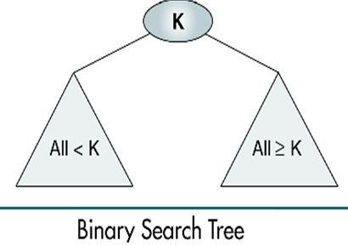
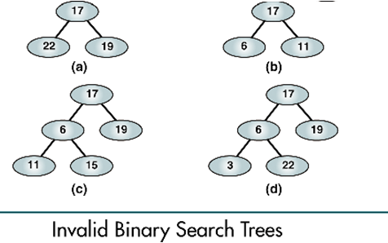
‹#›

Slide 62
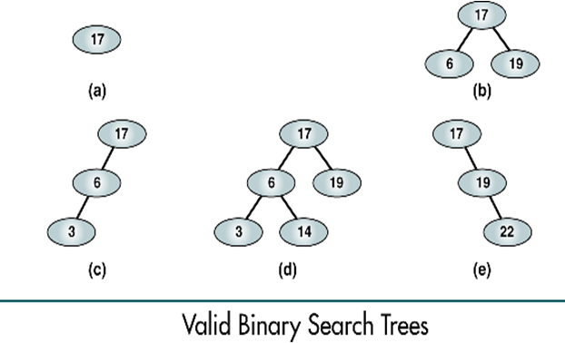
(a), (b) - complete and balanced trees;
(d) – nearly complete and balanced tree;
(c), (e) – neither complete nor balanced trees
‹#›

Slide 63
BST Examples
8, 3, 10, 1, 6, 14, 4, 7, 13
8
3
10
1
6
14
4
7
13
‹#›

Slide 64
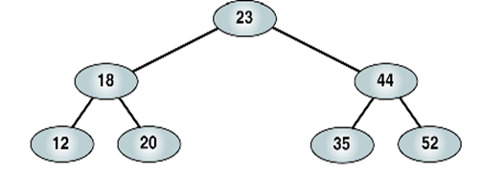
BST Operations
Traversals
Searches
Insertion
Deletion
‹#›

Slide 65
Preorder 23 18 12 20 44 35 52
Postorder 12 20 18 35 52 44 23
Inorder 12 18 20 23 35 44 52
Right-node-left 52 44 35 23 20 18 12
‹#›

Slide 66
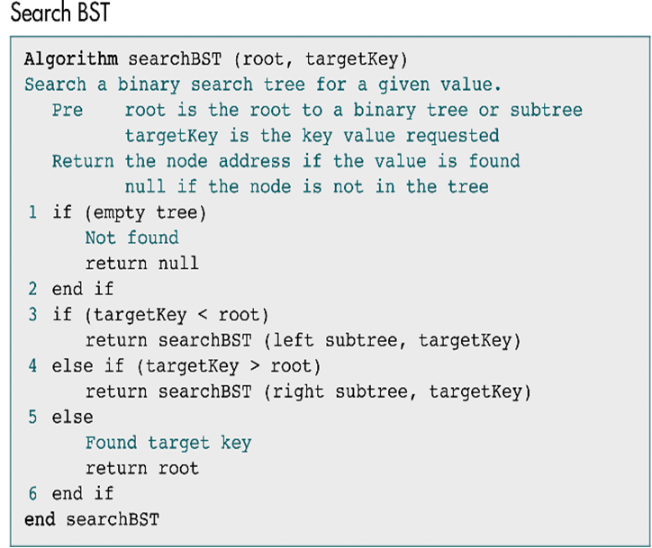
‹#›

Slide 67
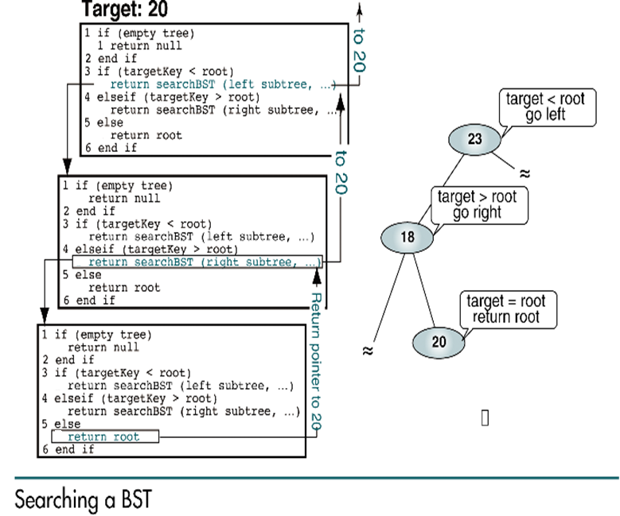
‹#›

Slide 68
BST Insertion
To insert data all we need to do is follow the branches to an empty subtree and then insert the new node.
In other words, all inserts take place at a leaf OR at a leaflike node – a node that has only one null subtree
‹#›

Slide 69
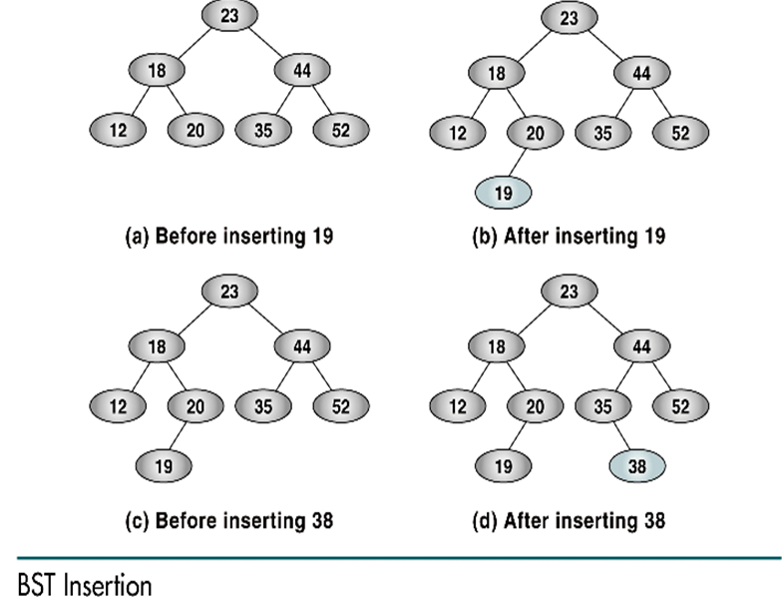
‹#›

Slide 70

Insert a node in BST
‹#›

Slide 71

‹#›

Slide 72
Draw binary search tree for following data --- 5 M
10, 08, 15, 12, 13, 07, 09, 17, 20, 18, 04, 05
‹#›

Slide 73
BST Deletion
CASES:
When a node is a leaf node
When a node has 1 child
When a node has 2 children
https://visualgo.net/bst (BST in order insertion deletion)
‹#›

Slide 74

Deletion of a leaf node
If the leaf node is left child of the parent then
Make the left pointer of its parent node as NULL and free the space for the node.
If the leaf node is right child of the parent then
Make the right pointer of its parent node as NULL and free the space for the node.
2 → Left child = NULL
‹#›

Slide 75

Example - Deletion of a leaf node
If(temp → left == NULL and temp → right== NULL) i.e. Leaf node
{
if(parent → left == temp) // leaf node is left child
parent → left = NULL; // left pointer of its parent node as NULL
else
parent → right = NULL; // right pointer of its parent node as NULL
Return;
}
20 → Left child = NULL
‹#›

Slide 76


Deletion of a node with 1 child
Delete 18
The node to be deleted is a left child of its parent?
Make link between the left pointer of its parent node and the child node to be deleted.
The node to be deleted is a right child of its parent?
Make link between the right pointer of its parent node and the child node to be deleted.
5 → Right child = 18 AND
18 → Right child
5 → Right child = 18 → Right child
5 → Right child = 21
‹#›

Slide 77
Deletion of a node with Right child
Delete 18
The node to be deleted has only right child AND is a right child of its parent
Make link between the right pointer of its parent node and the right child of node to be deleted.
If(temp → left == NULL && temp → right != NULL) // delete node with right child
{
if(parent → left == temp) // node to be deleted is a left child of its parent
parent → left = temp → right; // Link left pointer of parent & right child of node to be deleted
else // node to be deleted is a right child of its parent
parent → right = temp →right; // Link right pointer of parent & right child of node to be deleted
temp=NULL;
delete temp;
}
‹#›

Slide 78
Deletion of a node with Left child
If(temp → left != NULL && temp → right == NULL) // delete node with left child
{
if(parent → left == temp) // node to be deleted is a left child of its parent
parent → left = temp → left;
else // node to be deleted is a right child of its parent
parent → right = temp →left;
temp=NULL;
delete temp;
}
‹#›

Slide 79

‹#›

Slide 80


Deletion of a node having 2 children
Left side replacement
Locate the node say t with maximum value from the left sub-tree of the node to be deleted.
Replace the node value to be deleted by the node found i.e. t
Maximum value from left subtree is in-order predecessor of the node to be deleted.
Delete 12
Right side replacement
Locate the node say t with minimum value from the right sub-tree of the node to be deleted.
Replace the node value to be deleted by the node found i.e. t
Minimum value from right subtree is in-order successor of the node to be deleted.
‹#›

Slide 81

maximum value from the left sub-tree
‹#›

Slide 82
BST operations
Same as inorder;
Instead of print, increment the count
count = 0;
Count_nodes(node *temp)
{
if(temp!=NULL)
{
Count_nodes(temp→leftchild);
count++;
Count_nodes(temp → rightchild);
}
}
‹#›

Slide 83
Threaded Binary Tree
Speeding up traversals

Slide 84

Threaded Binary Tree
In a binary tree, there are many nodes that have an empty left child or empty right child or both.
In a linked representation of a binary tree, the number of null links (null pointers) are actually more than non-null pointers.
Total 12 pointers
7 null pointers
5 actual pointers
‹#›

Slide 85
Threaded Binary Tree
In general, for any binary tree with n nodes there will be -
(n+1) null pointers and
2n total pointers.
Objective : make effective use of these null pointers ( A. J. perils & C. Thornton )
i.e. Replace all the null pointers by the appropriate pointer values called threads.
Binary tree with such pointers are called threaded binary tree.
Utilize these fields in such a way so that -
Empty left child of a node points to its inorder predecessor.
Empty right child of the node points to its inorder successor.
‹#›

Slide 86
Threaded Binary Tree
One way threading:-
A thread appears in a right field (empty right child) of a node and points to the next node in the inorder traversal (inorder successor).
Two way threading:-
A thread ALSO appears in the left field of a node and points to the preceding node in the inorder traversal (inorder predecessor).
‹#›

Slide 87

Threaded Binary Tree
9 NULL pointers
In-order :- 30 40 50 60 65 69 72 80
‹#›

Slide 88

One-Way Threaded Binary Tree
The empty left child field of a node can be used to point to its inorder predecessor. OR
The empty right child field of a node can be used to point to its in-order successor.
A field holding the address of its in-order successor is known as thread.
Right Threaded Binary Tree
In-order :- 30 40 50 60 65 69 72 80
‹#›

Slide 89

Two-Way Threaded Binary Tree
The empty left child field of a node can be used to point to its inorder predecessor. AND
The empty right child field of a node can be used to point to its in-order successor.
In-order :- 30 40 50 60 65 69 72 80
‹#›

Slide 90

Threaded Binary Tree
In-order :- 30 40 50 60 65 69 72 80
‹#›

Slide 91

‹#›

Slide 92

Threaded Binary Tree
The threaded binary tree is represented as the left child of the header node.
‹#›

Slide 93

Threaded Binary Tree - Representation
In the memory representation of a threaded binary tree, it is necessary to distinguish between a normal pointer and a thread.
The structure of a node in a threaded binary tree is a bit different from that of a normal binary tree.
Each node of a threaded binary tree contains two extra pieces of information, namely left thread and right thread.
The left and right thread fields of a node can have two values:
0: Indicates a normal link to the child node
1: Indicates a thread pointing to the inorder predecessor or inorder successor
‹#›

Slide 94

Threaded Binary Tree: One-Way (Inorder threading)
Inorder :
D,B,F,E,A,G,C,L,J,H,K
‹#›

Slide 95
Two-Way Threaded Binary Tree -
A thread will also appear in the left field of a node and will point to the preceding node in the in-order traversal of tree T.
The left pointer of the first node and the right pointer of the last node will contain the null value.
Inorder :
D,B,F,E,A,G,C,L,J,H,K
‹#›

Slide 96

Two-Way Threaded Binary Tree with Header Node
The NULL left pointer of the first node and the NULL right pointer of the last node points to the Header Node.
Left
Right
Inorder :
D,B,F,E,A,G,C,L,J,H,K
‹#›

Slide 97
Threaded Binary Tree
Example : Give Linked representation with the threads.
In-order traversal -G,F,B,A,D,C,E
A
B
C
F
D
E
G
‹#›

Slide 98

Threaded Binary Tree
Linked representation with the threads.
In-order traversal -G,F,B,A,D,C,E
‹#›

Slide 99

Right Threaded Binary Search Tree
Root
‹#›

Slide 100
Right Threaded Binary Search Tree
Root
‹#›

Slide 101
Example
Root
‹#›

Slide 102
Example
Root
‹#›

Slide 103
Example
Root
‹#›

Slide 104
Example
Root
‹#›

Slide 105
Example
Root
‹#›

Slide 106
Example
Root
‹#›

Slide 107
Threaded Binary Tree
Advantages of threaded binary tree:
The traversal operation is more faster than that of its unthreaded version
With threaded binary tree non-recursive implementation is possible which can run faster and does not require the botheration of stack management.
We can efficiently determine the predecessor and successor nodes starting from any node.
Any node can be accessible from any other node.
Threads are usually move to upward whereas links are downward.
One can move in their direction and nodes are in fact circularly linked.
‹#›

Slide 108
Threaded Binary Tree
Disadvantages of threaded binary tree:
Insertion into and deletions from a threaded tree are although time consuming operations but these are very easy to implement.
This tree require additional bit to identify the threaded link.
‹#›

Slide 109
In a threaded binary tree, the right thread of a node points to its inorder ___________, and the left thread points to its inorder ____________.
‹#›

Slide 110
Insertion in Threaded Binary Tree
20
18
39
15
25
45
12
‹#›

Slide 111


Insertion in TBT
NULL
0
20
0
0
18
1
0
39
0
0
15
1
1
25
1
1
55
1
1
12
1
Insert 16
Insert 22
Find appropriate empty subtree
As 16 is GREATER than 15;
16 → right = 15 → right;
16 → left = 15;
15 → right = 16
15 → rthread = 0;
Find appropriate empty subtree
As 22 is LESS than 25;
22 → left = 25 → left;
22 → right = 25;
25 → left = 22
25 → lthread = 0;
‹#›

Slide 112


Insertion in Threaded Binary Tree
‹#›

Slide 113

Insertion in Threaded Binary Tree
‹#›

Slide 114


‹#›

Slide 115

Display (Inorder) TBT
‹#›

Slide 116
Deletion in threaded binary tree
Leaf node
A node with 1 child
A node with 2 children
NULL
0
20
0
0
18
1
0
39
0
0
15
1
1
25
1
1
55
1
1
12
1
‹#›

Slide 117

Deletion
NULL
Perform following delete operation and redraw the TBT
Delete 14
Delete 17
Delete 10
‹#›

Slide 118

Insertion
NULL
Add following numbers and redraw the TBT
Insert 13
Insert 15
‹#›

Slide 119
Case Study- Use of binary tree in expression tree-evaluation and Huffman's coding
‹#›

Slide 120
Expression Tree
Operands are attached as leaf nodes and operators are the internal nodes.
Traversals are applied in Expression tree to get infix, prefix and postfix expression.
‹#›

Slide 121
Create an expression tree from postfix expression
Scan the given expression Left to Right.
If it is an operand then
Make a node; set left and right pointers as NULL
Push the node to stack.
If it is an operator then
Make a node; Pop 2 nodes
1st popped node is attached as right child
2nd popped node is attached as left child.
Push the node to stack.
Repeat the above process till expression is scanned and stack is empty
‹#›

Slide 122
Expression tree from postfix expression
Examples
AB+CDE/-*
945*86/-/
321*76/+
321*77/+ is an invalid expression;
For Valid expressions
#operands = #operators + 1
OR
#operators = #operands - 1
‹#›

Slide 123


Pseudo code – Postfix to expression tree
‹#›

Slide 124

Pseudo code – Postfix to expression tree
‹#›

Slide 125
Create an expression tree from prefix expression
Scan the given expression Right to Left.
If it is an operand then
Make a node; set left and right pointers as NULL
Push the node to stack.
If it is an operator then
Make a node; Pop 2 nodes
1st popped node is attached as left child
2nd popped node is attached as right child.
Push the node to stack.
Repeat the above process till expression is scanned and stack is empty
‹#›

Slide 126

Pseudo code – Prefix to expression tree
‹#›

Slide 127

Pseudo code – Prefix to expression tree
‹#›

Slide 128
A Binary Expression Tree
‘*’
‘+’
‘3’
‘4’
‘2’
What value does it have?
( 4 + 2 ) * 3 = 18
‹#›
Notes:
‹#›

Slide 129
A Four-Level Binary Expression
‘*’
‘-’
‘/’
‘8’
‘5’
‘+’
‘3’
‘4’
‘2’
‹#›
Notes:
‹#›

Slide 130
Expression Tree Examples
Expression
Expression Tree
Inorder Traversal Result
(a+3)
a + 3
+
a
3
3+(4*5-(9+6))
3+4*5-9+6
+
3
-
*
+
log(x)
4
5
9
6
log x
log
x
n!
n !
!
n
‹#›

Slide 131
Revision
Balanced Tree
Binary Search tree
Operations on BST
Create/Insert
Search
Display
Delete (leaf node/Node with 1 child & node with 2 children)
Recursive pseudocode for various operations on BST
How TBT differs from BST?
TBT can be generated only for BST- True or false?
Given infix/prefix/postfix; can we generate expression tree? How?
Create optimal Binary Tree for the keys (37 18 29 13 30 17 6) using Huffman Algorithm and find the prefix codes.
‹#›

Slide 132
Quiz
The no of external nodes in a full binary tree with n internal nodes is? a) n b) n+1 c) 2n d) 2n + 1
Which of the following statement about binary tree is CORRECT? a) Every binary tree is either complete or full b) Every complete binary tree is also a full binary tree c) Every full binary tree is also a complete binary tree d) A binary tree cannot be both complete and full
In full binary search tree every internal node has exactly two children. If there are 100 leaf nodes in the tree, how many internal nodes are there in the tree? a) 25 b) 49 c) 99 d) 101
‹#›

Slide 133
Which type of traversal of binary search tree outputs the value in sorted order? a) Pre-order b) In-order c) Post-order d) None
If a node having two children is to be deleted from binary search tree, it is replaced by its a) In-order predecessor b) In-order successor c) Pre-order predecessor d) None
If n elements are sorted in a balanced binary search tree. What would be the asymptotic complexity to search a key in the tree? a) O(1) b) O(logn) c) O(n) d) O(nlogn)
‹#›

Slide 134
A threaded binary tree is a binary tree in which every node that does not have left child has a thread to its a) Pre-order successor b) In-order successor c) In-order predecessor d) Post-order successor
A binary search tree is generated by inserting in order the following integers: 50, 15, 62, 5, 20, 58, 91, 3, 8, 37, 60, 24 The number of the node in the left & and right sub-tree of the root, respectively is a) (4, 7) b) (7, 4) c) (8, 3) d) (3, 8)
Level order traversal of a tree is formed with the help of
a) breadth first search b) depth first search c) dijkstra’s algorithm d) prims algorithm
‹#›

Slide 135
Why we prefer threaded binary trees?
a) storage required by stack and queue is more b) pointers in most of nodes of a binary tree are NULL c) difficult to find a successor node d) all of the mentioned
What is a threaded binary tree traversal?
a) a binary tree traversal using stacks b) a binary tree traversal using queues c) a binary tree traversal using stacks and queues d) a binary tree traversal without using stacks and queues
What are null nodes filled with in a threaded binary tree?
a) inorder predecessor for left node & inorder successor for right node information b) right node with inorder predecessor & left node with inorder successor information c) they remain null d) some other values randomly
‹#›

Slide 136
Course Objective of TREE data structure-
To suggest appropriate non-linear data structure and algorithm for graphical solutions of the problems.
Course Outcome –
Build solutions using various non-linear data structures for representing hierarchical data.
Organize data in some order and search it easily.
Analyze and implement various searching and traversal techniques.
‹#›

